Slide 1
K-Nearest Neighbor Algorithm

Slide 2
K-Nearest Neighbour is a supervised learning algorithm
Supervised learning (SL) is a machine learning paradigm for problems where the available data consists of labeled examples, meaning that each data point contains features (covariates) and an associated label.

Slide 3
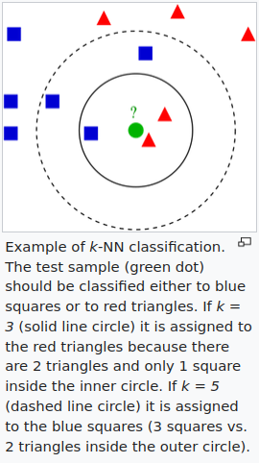
kNN can be used for classification and also for regression.
Note: For the purpose of study, we will focus on classification.
In k-NN classification, the output is a class membership.
An object is classified by a plurality vote of its neighbors, with the object being assigned to the class most common among its k nearest neighbors (k is a positive integer, typically small). If k = 1, then the object is simply assigned to the class of that single nearest neighbor.
In k-NN regression, the output is the property value for the object. This value is the average of the values of k nearest neighbors. If k = 1, then the output is simply assigned to the value of that single nearest neighbor.

Slide 4
K-NN is a non-parametric algorithm
K-NN is a non-parametric algorithm, which means it does not make any assumption on underlying data.
Nonparametric statistics is the branch of statistics that is not based solely on parametrized families of probability distributions (common examples of parameters are the mean and variance). Nonparametric statistics is based on either being distribution-free or having a specified distribution but with the distribution's parameters unspecified.

Slide 5
Side note: Parametric Machine Learning Algorithms
The parametric algorithms involve two steps:
1. Select a form for the function.
2. Learn the coefficients for the function from the training data.
An easy to understand functional form for the mapping function is a line, as is used in linear regression:
b0 + b1*x1 + b2*x2 = 0

Slide 6
Examples of Parametric Learning Algorithms
Some more examples of parametric machine learning algorithms include:
Logistic Regression
Linear Discriminant Analysis
Perceptron
Naive Bayes
Simple Neural Networks
Comments:
Logistic Regression: is a linear model
Linear Discriminant Analysis: as the name suggests is a linear model
Perceptron: it is based on the equations similar to logistic regression
Naive Bayes
Simple Neural Networks: are based on perceptron

Slide 7
Benefits and Limitations of Parametric Models
Benefits of Parametric Machine Learning Algorithms:
Simpler: These methods are easier to understand and interpret results.
Speed: Parametric models are very fast to learn from data.
Less Data: They do not require as much training data and can work well even if the fit to the data is not perfect.
Limitations of Parametric Machine Learning Algorithms:
Constrained: By choosing a functional form these methods are highly constrained to the specified form.
Limited Complexity: The methods are more suited to simpler problems.
Poor Fit: In practice the methods are unlikely to match the underlying mapping function.

Slide 8
Nonparametric Machine Learning Algorithms
Algorithms that do not make strong assumptions about the form of the mapping function are called nonparametric machine learning algorithms. By not making assumptions, they are free to learn any functional form from the training data.
Nonparametric methods are good when you have a lot of data and no prior knowledge, and when you don’t want to worry too much about choosing just the right features.
— Artificial Intelligence: A Modern Approach, page 757

Slide 9
Nonparametric Models: Some examples
Some more examples of popular nonparametric machine learning algorithms are:
k-Nearest Neighbors
Decision Trees like CART and C4.5
Support Vector Machines

Slide 10
Benefits and Limitations of Nonparametric Models
Benefits of Nonparametric Machine Learning Algorithms:
Flexibility: Capable of fitting a large number of functional forms.
Power: No assumptions (or weak assumptions) about the underlying function.
Performance: Can result in higher performance models for prediction.
Limitations of Nonparametric Machine Learning Algorithms:
More data: Require a lot more training data to estimate the mapping function.
Slower: A lot slower to train as they often have far more parameters to train.
Overfitting: More of a risk to overfit the training data and it is harder to explain why specific predictions are made.

Slide 11
KNN is a lazy learner algorithm.
It is also called a lazy learner algorithm because it does not learn from the training set immediately instead it stores the dataset and at the time of classification, it performs an action on the dataset.

Slide 12
Lazy Learner vs Eager Learner
Lazy learner:
Just store Data set without learning from it
Start classifying data when it receive Test data
So it takes less time learning and more time classifying data
Eager learner:
When it receive data set it starts classifying (learning)
Then it does not wait for test data to learn
So it takes long time learning and less time classifying data
Hint : In supervised learning
Some examples are :
Lazy : K - Nearest Neighbour, Case - Based Reasoning
Eager : Decision Tree, Naive Bayes, Artificial Neural Networks

Slide 13
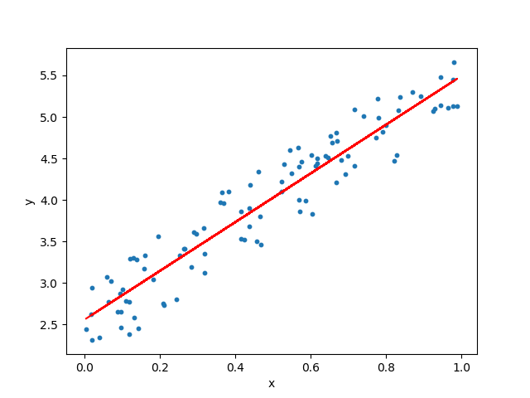
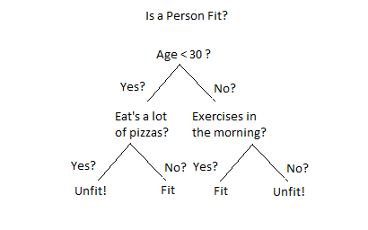
Side note: Eager Learning
What is learnt as part of Eager Learning?
Explaining by example:
We know about Linear Regression that it fits a line to the data.
At the time of prediction, we query the equation of the line with our inputs.
We also know about Decision Tree for classification that fits a (kind of) map to the data to make classifications.
At the time of prediction, we simply have to go through a path in the map based on our input to reach the leaf node containing the information about input data point’s class.

Slide 14
How does K-NN work?
The K-NN working can be explained on the basis of the below algorithm:
Step-1: Select the number K of the neighbors
Step-2: Calculate the Euclidean distance of neighbors from the input data point
Step-3: Take the K nearest neighbors as per the calculated Euclidean distance.
Step-4: Among these k neighbors, count the number of the data points in each category.
Step-5: Assign the new data points to that category for which the number of the neighbor is maximum.
Step-6: Our model is ready.

Slide 15
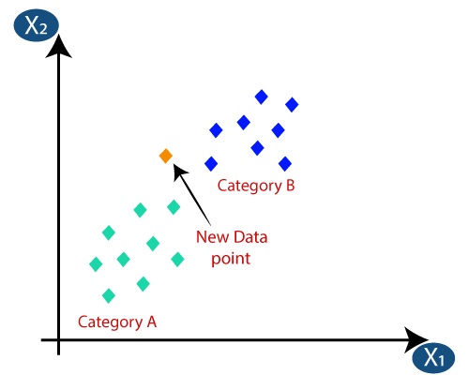
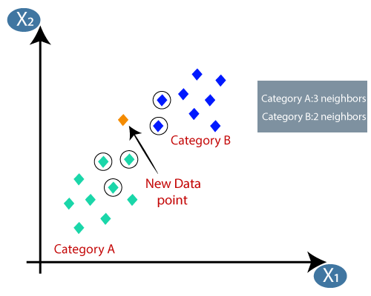
A Graphical Example
KNN for k = 5:

Slide 16
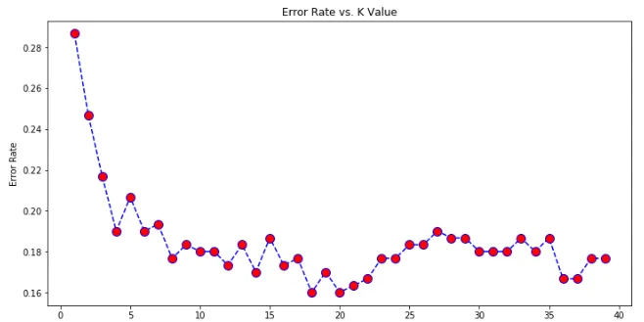
Elbow Method For Finding Optimal K Value
Steps:
Create a for loop that trains various KNN models with different k values, then keep track of the error_rate for each of these models with a list.
The optimal value of K is 20. The graph of the error rate increases after 20.

